Slide 1
Internet of Decks
George Fortune, Angus and Jamie Wood

Slide 2
Idea
Clothing that flashes in time to the music that is being currently played on the DJs laptop.
3 different ways that the LEDs strip can light up.
This is controlled by a phone app together with turning it on and off.
The flashing of the LEDs is completely synchronous with the beat of the music.

Slide 3
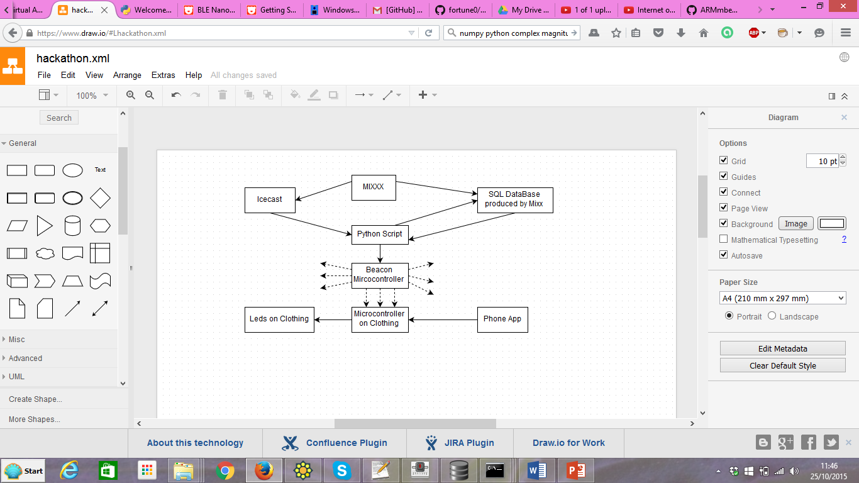
Block Diagram of Project

Slide 4
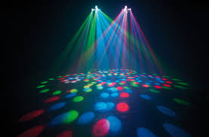
Demonstration

Slide 5
Extensions
The BPM for the song can potentially be subdivided into the BPM for smaller sections of the song. This would mean that the project would work also with songs which have a rapidly changing BPM such as Folk.

